Slide 1

Evaluating Production Bottlenecks
Insights and Recommendations Through Downtime Analysis
Presented by Collins Agyei

Slide 2
Key Performance Indicators
645
Batches Produced
Total production runs.
363
Delayed Batches
Batches experiencing
production delays.
22
Days Lost
Total days lost due to
downtime.
885
Downtime Factors
Total instances of contributing factors.
13
Unique Downtime Factors
Distinct instances of contributing
factors.
4
Max Factors Per Batch
Maximum instances of contributing factors per
batch.

Slide 3
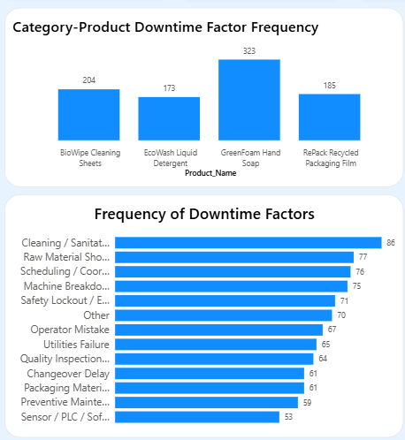
Product Downtime Frequency
GreenFoam Hand Soap recorded the highest downtime frequency (323), indicating it was the most affected product.
Cleaning and Sanitation (86) was the leading cause of downtime, followed by Raw Material Shortage (77) and Scheduling and Coordination issues (76)
Sensor/PLC/Software Issues (53) were the least frequent cause of downtime.
Reducing these key downtime factors can improve production efficiency and minimize operational delays.

Slide 4
The Root Causes of Downtime
Operator Factors
Operator errors accounted for 31% of total downtime, indicating that a smaller proportion of production interruptions resulted from operator mistakes and human error.
Non-Operator Factors
Non-operator errors accounted for 69% of total downtime, indicating that most production interruptions were caused by machine breakdowns, raw material shortages, cleaning activities, and scheduling issues.

Slide 5
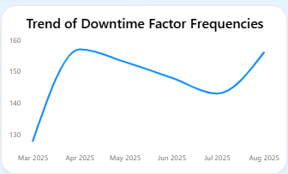
Downtime Trends (March – August 2025)
Downtime increased sharply in April, declined steadily until July, and rose again in August.
March: Recorded the lowest downtime during the six-month period.
April: Downtime peaked, indicating a significant increase in production disruptions.
May–July: Downtime gradually declined, suggesting improvements in operational performance.
August: Downtime increased again, indicating that production challenges re-emerged.

Slide 6
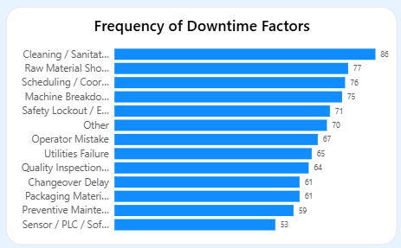
Consistent Downtime Causes
Cleaning/Sanitation
Material Shortage
Scheduling/Coordination Delay
Machine Breakdown
Safety Lockout
Cleaning and sanitation was the most frequent cause of downtime (86 occurrences).Raw material shortages, scheduling issues, and machine breakdowns consistently contributed to production downtime, with 77, 76, and 75 occurrences, respectively. These findings indicate that operational processes and equipment reliability were the primary drivers of production interruptions.

Slide 7
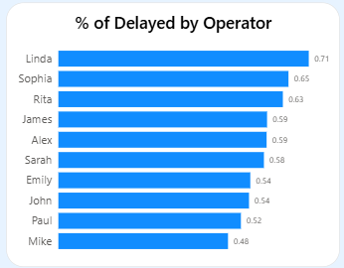
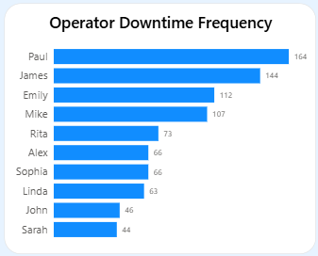
Operator Downtime
Operators with higher downtime frequencies were likely affected by the same key operational issues identified earlier, including machine breakdowns, raw material shortages, cleaning/sanitation, and scheduling delays.
Paul recorded the highest downtime frequency, followed by James and Emily, indicating they experienced the most downtime events.
Although Paul had the highest number of downtime events, Linda recorded the highest percentage of delayed batches, followed by Sophia and Rita .

Slide 8

Downtime Impact: Time Lost
Frequency of downtime directly correlates with total time spent in downtime
Primary Causes of Lost Time
vCleaning/Sanitation resulted in the highest downtime hours, making it the largest contributor to production time loss.
vRaw Material Shortages, Scheduling/Coordination Issues, and Machine Breakdowns also caused significant downtime, each exceeding 75 hours.
Operators with Most Time Wasted
v Paul recorded the highest total downtime, indicating the greatest amount of production time lost.
James and Emily also experienced significant downtime, contributing to overall production delays

Slide 9

Scheduling Gaps Identified
v The analysis identified gaps in operator scheduling during batch production.
v Assigning operators to handle two or more products concurrently may contribute to increased downtime and reduced production efficiency.

Slide 10

Recommendations for Improvement
Inventory & Alerts
Introduce real-time inventory tracking and automated low raw material alerts.
Preventive Maintenance
Schedule regular preventive maintenance for high-downtime machines.
Batch Scheduling
Implement better production scheduling and sequencing to avoid batch overlaps.
Operator Training & Workload
Provide targeted operator training and review workload allocation to improve productivity.
Downtime Reviews
Conduct regular downtime reviews and implement early warning systems for proactive decision-making.

Slide 11
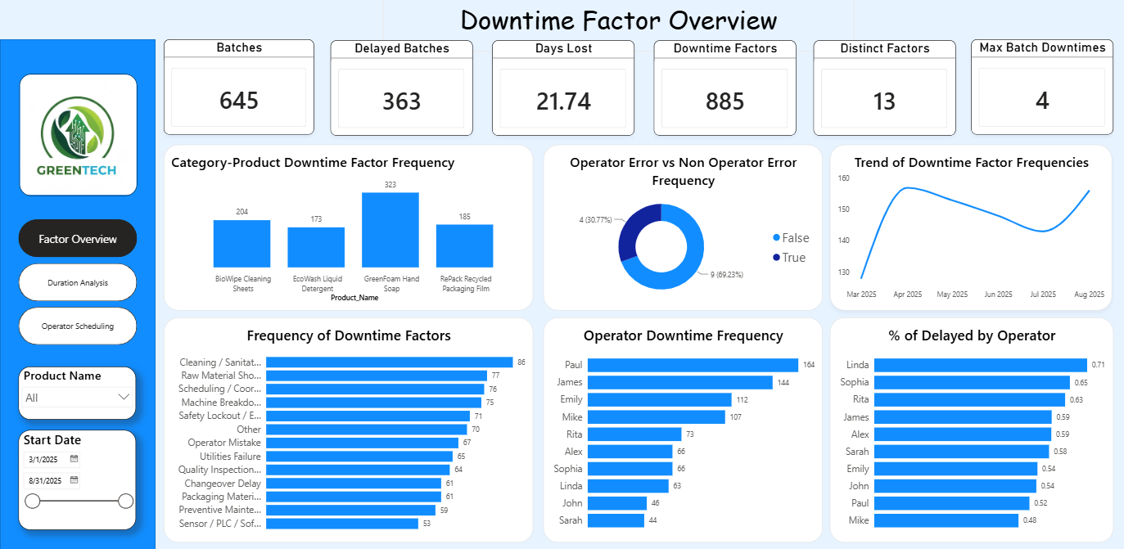

Slide 12
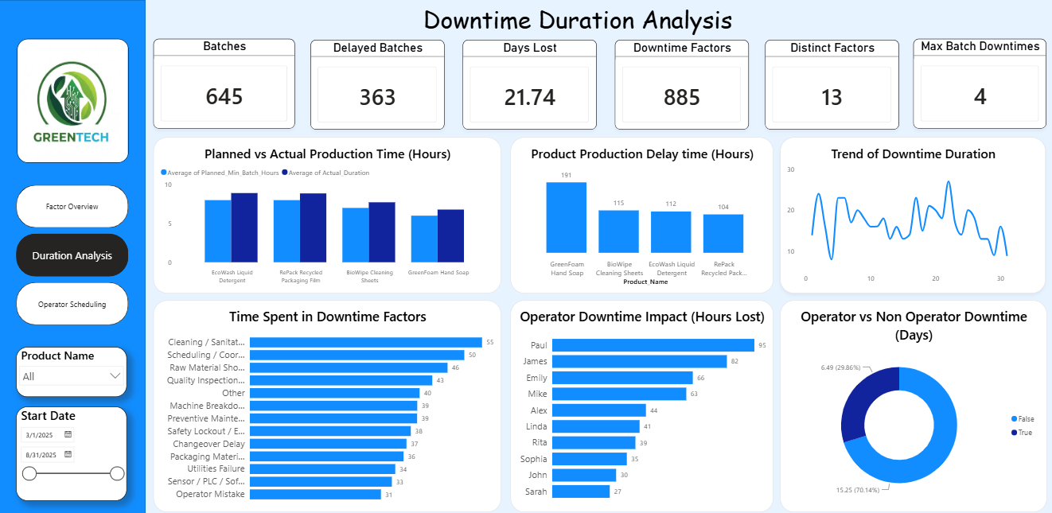

Slide 13
